Slide 1
Body Fat Prediction
Group 6:
Kai Shukla, Abigail Sikora, Yeming Wei

Slide 2
Introduction
In today's fast-paced world, people are increasingly paying attention to their health.
Body fat percentage can serve as a good indicator of one's physical condition.
This project explores the relationship between various body measurements and their potential predictive power for body fat in U.S. adult men.

Slide 3
Data cleaning
Deleted rows:
Indo | Reason
96 | Body fat < 3%
172 | Body fat <3%
182 | Body fat <3%
42 | Individual was very short, 74.93 cm (outlier)
39 | Adiposity was over 40 (outlier)
216 | Body fat was over 40% (outlier)
Imputed rows:
Indo | Column | Original Value | Updated Value
96 | Body fat | 17.3 | 0.37
172 | Body fat | 1.9 | 0.69
182 | Body fat | 0 | -3.611
163 | Adiposity | 24.4 | 27.4
221 | Adiposity | 24.5 | 21.7
Final data set: 246 rows with 14 possible predictors

Slide 4
Finding the Best Model
Metric for Model Performance: We’ll defined the “best” model based on the following criteria:
R-Squared Value
Predictors are easily measurable
Candidate Models: Linear model with at most 2 predictors

Slide 5
Results
Model | Multiple R-Squared Value | Adjusted R-Squared Value
Body fat ~ Abdomen | 0.659 | 0.6576
Body fat ~ Abdomen + Height | 0.6939 | 0.6913
Body fat ~ Abdomen + Neck | 0.6863 | 0.6837
Body fat ~ Abdomen + Wrist | 0.6977 | 0.6952

Slide 6
Discussion of Results
The predictor abdomen was significant across all models evaluated.
By including wrist we increased the adjusted R^2 value by 3.76%.
Wrist and abdomen are easily measurable by an individual.

Slide 7
Final Model
BODYFAT = -10.1784 + 0.7132*ABDOMEN - 2.0181*WRIST
Description: Assuming wrist measurement remains constant, each centimeter increase in abdomen increased the body fat percentage by 0.7132. Assuming abdomen measurement remains constant, each centimeter increase in wrist decreased body fat percentage by 2.0181.
Example: An average male with a 17cm wrist and 102cm abdomen, we predict his body fat percentage to be 28.26%.

Slide 8
Statistical Properties of Final Model
The abdomen and wrist coefficients are both highly significant with p-values less than 0.05
The overall model is significant with F-statistic of 280.4 and a very low p-value.
The residual standard error is 4.077 so on average the actual body fat percentage values are expected to deviate by about 4.077 percent.

Slide 9
Model Diagnostics
To test for linearity and homoscedasticity we plotted the fitted values vs the residuals.
To test for normality of the residuals we used a Q-Q plot.
To test for multicollinearity we used variance inflation factor (VIF). Both abdomen and wrist had a VIF of about 1.57.

Slide 10
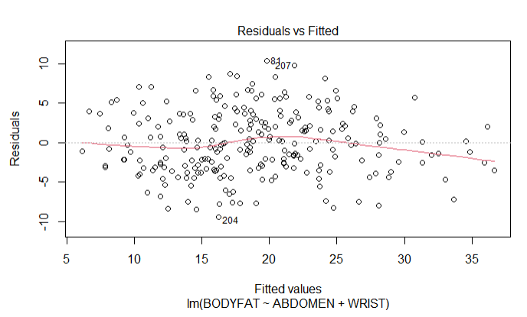

Slide 11
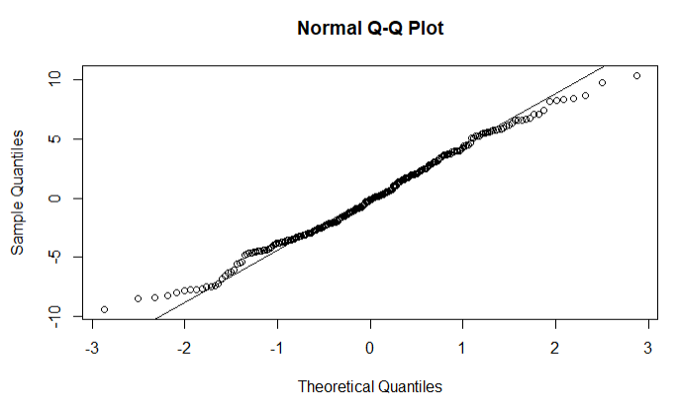

Slide 12
Strengths & Weaknesses
Strengths:
Simplicity and ease of use.
69.77% of variability observed in body fat is explained by our model.
Weaknesses:
Can only be used for the average male.
Includes limited data size and only for adult males (246 individuals)
Abdomen value can vary throughout the day.

